Slide 1
LG ELECTRONICS DEVELOPMENT VIETNAM
Accessing Guideline for Guest
LGEDV｜ 2024. Sep

Slide 2
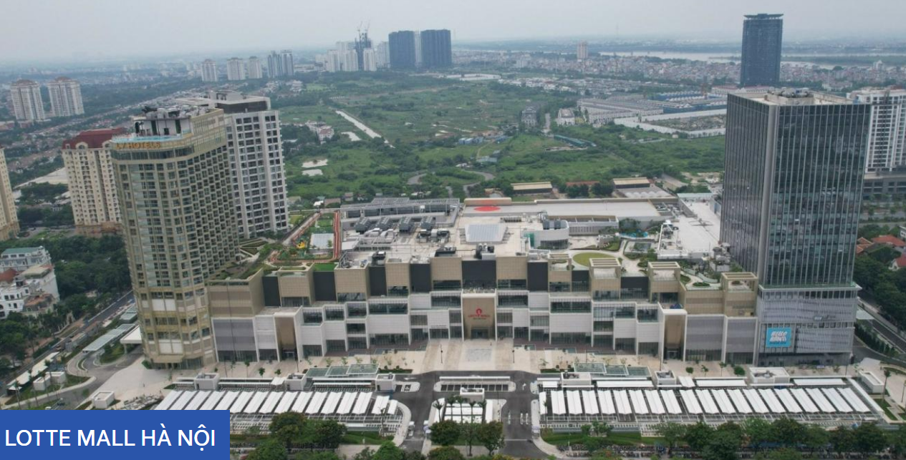
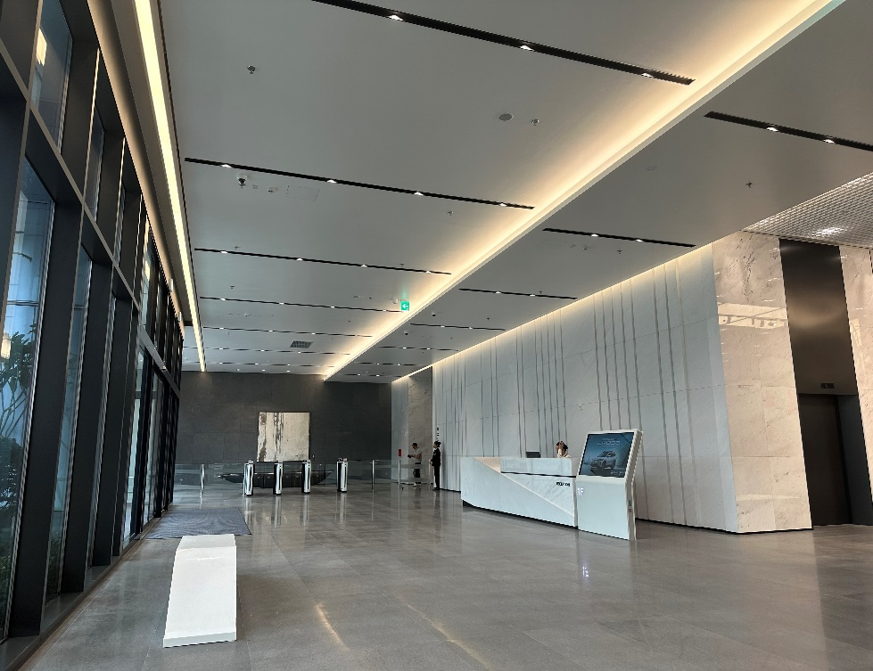
I. Guideline to access Lotte Office Tower – No Parking
Office building
Way to Office lobby of Lotte Office Building (single black building)
Entrance from 2 sides: Lac Long Quan or Vo Chi Cong Street
1. At first floor - registration with Lotte Office Receptionist by showing your ID card and find your name on Visitor Form (LG informed guest name to Lotte Receptionist in advance already), fill in any missing information in the Visitor Form and sign on it.
2. Lotte receptionist will help you access elevator
3. When reaching the desired floor, please register with Security by showing your ID card. Your personal belonging will be kept at security area and then you will be escorted to the waiting lounge.

Slide 3
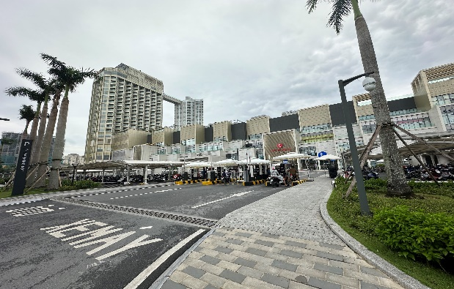
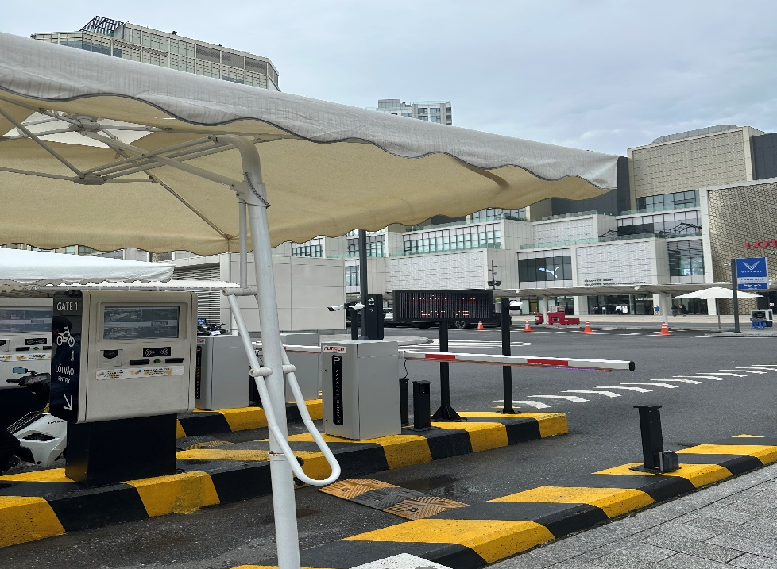
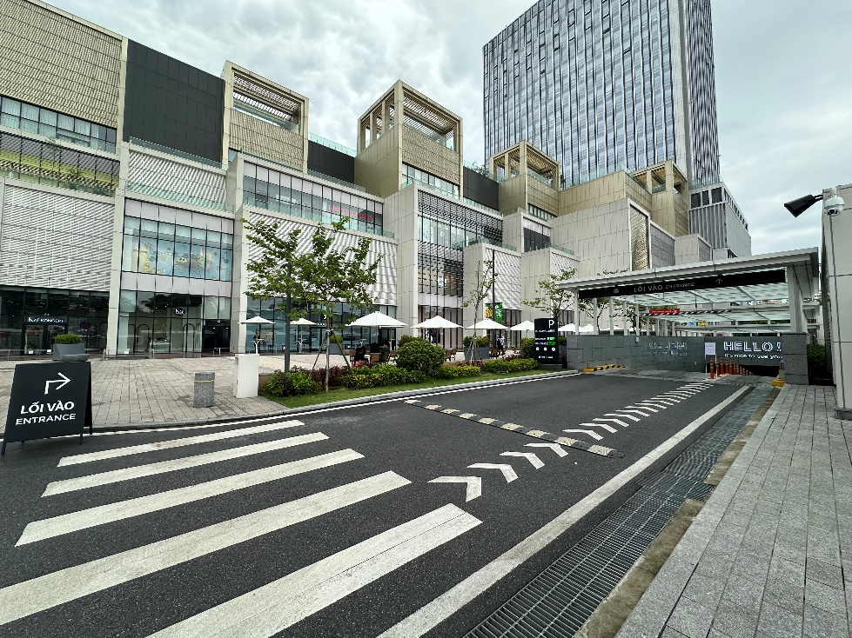
II. Guideline to access Lotte Office Tower - Parking
Office building
1. Move to the parking lot entrance on Lac Long Quan Street
Note: Currently, Lotte only deploys parking areas on the ground and 2 basement (B1, B2)
2. Stop the vehicle and take the ticket.
3. Continue moving to the entrance of the B1 parking garage. Remember to stick to proper lane.

Slide 4
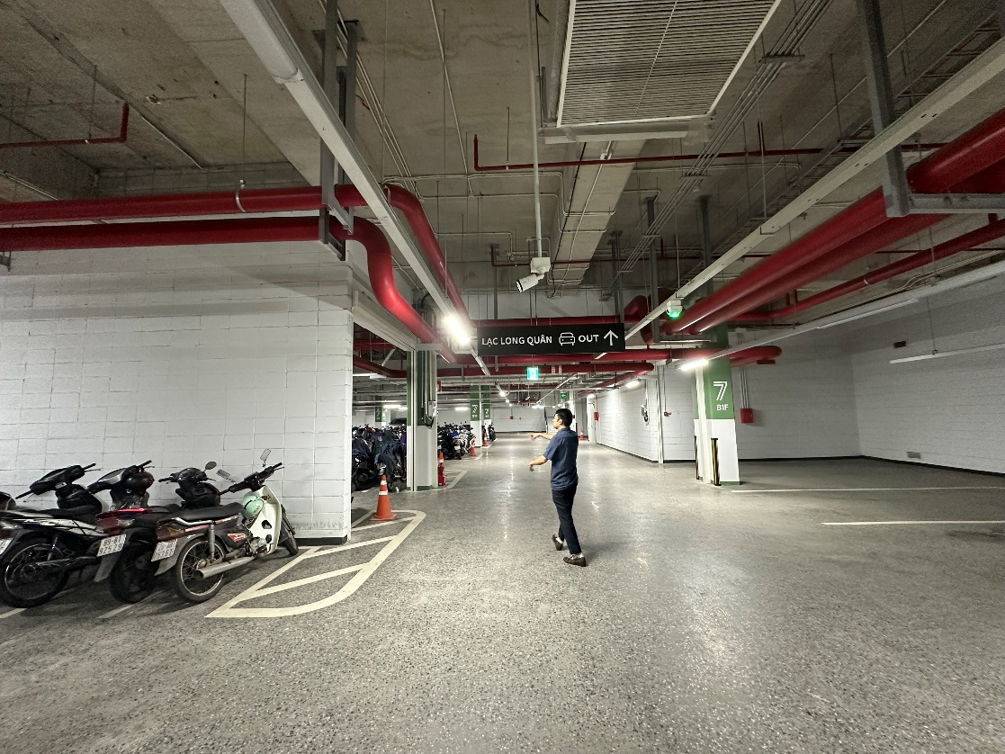
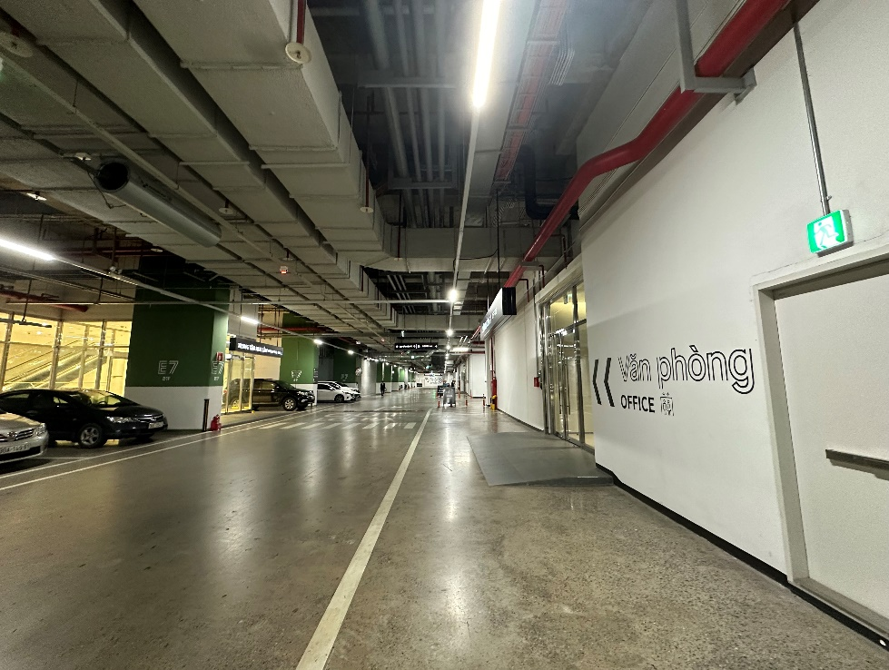
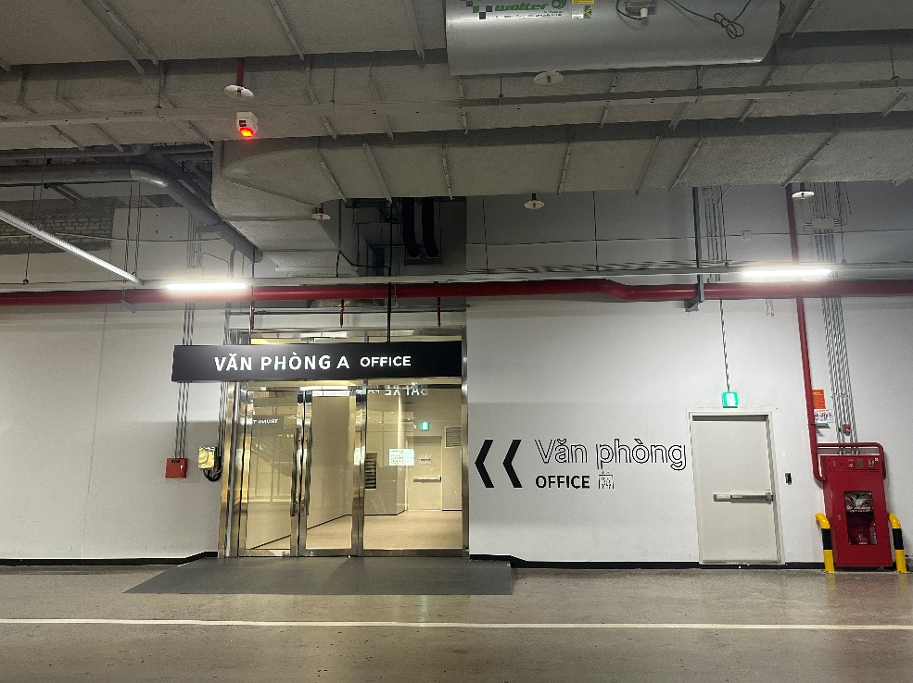
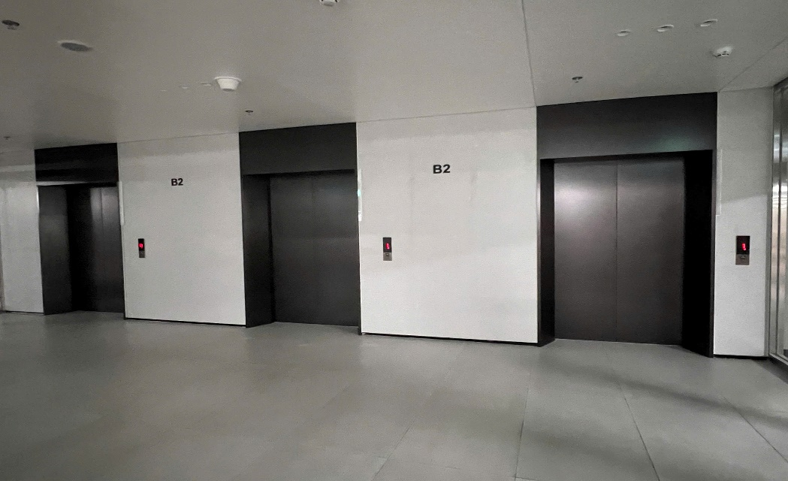
II. Guideline to access Lotte Office Tower
4. After parking, move to column E7 of B1 parking garage. Tips: Follow the sign for Lac Long Quan exit for cars.
5. Move to column E7. The elevator entrance to the 1F is on the right.

Slide 5
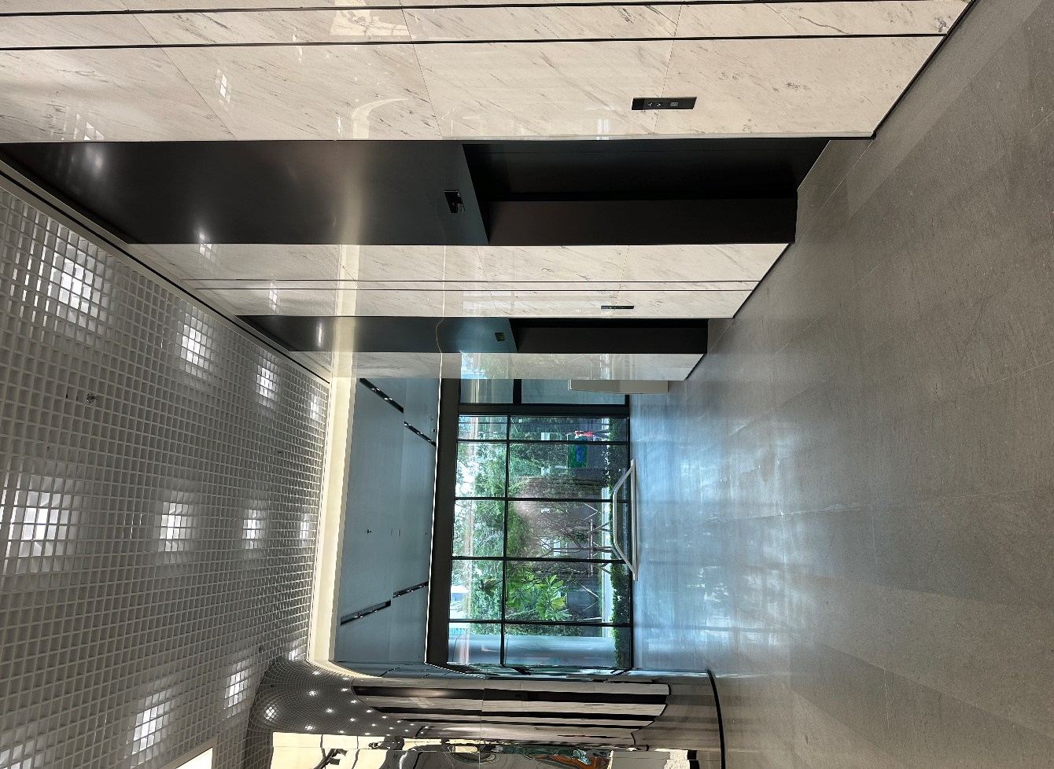
II. Guideline to access Lotte Office Tower
6. After going to the 1F, move to the right, to the area with the speed gate and reception desk.
At first floor - registration with Lotte Office Receptionist by showing your ID card and find your name on Visitor Form (LG informed guest name to Lotte Receptionist in advance already), fill in any missing information in the Visitor Form and sign on it.
Lotte receptionist will help you access elevator
When reaching the desired floor, please register with Security by showing your ID card. Your personal belonging will be kept at security area and then you will be escorted to the waiting lounge.

